Slide 1



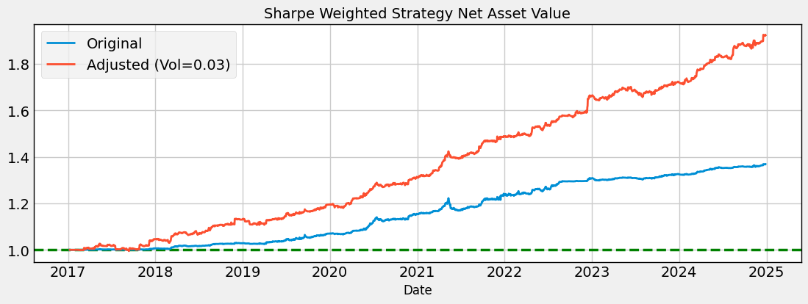
Futures Pairs Trading Strategies
Authors: Fan Xuan, Jiang Zhuoyan
Student IDs: 120090803, 120040052
概述 Abstract
项目亮点 Project Highlight
Arbitrage arises whenever the long‑run price equilibrium between related commodity futures briefly breaks down. To capture these fleeting gaps, we begin by screening for highly liquid contracts, then match those with clear supply‑chain or substitution links, and finally verify each pair’s cointegration through ADF and Engle‑Granger tests.
We design two trading strategies:
Z-score strategy: When the price spread’s z-score is too high or too low, we take positions based on the belief it will revert to the mean.
CUSUM strategy: roll 30‑day β, use volatility‑scaled CUSUM with signal‑strength‑driven holding periods.
Portfolio Build Correlated pairs → equal‑weight clusters → merged with another strategy using volatility-adjusted weights
Back‑test 2017‑2025 92.6 % Cumulative Return ‧ Sharpe 2.31 ‧ Max Drawdown 3.1 %. Result: equity‑like returns, bond‑like risk.
1. Realistic Backtesting System
Built a practical backtesting framework that simulates real trading conditions by incorporating adjustable initial capital and slippage settings.
One‑click grid search sweeps 200 + parameter sets, recording Sharpe, drawdown, and trade stats for reproducible optimization.
2. Statistical Arbitrage Pair Selection
Industry supply‑chain logic + ADF / Engle‑Granger cointegration (p < 0.05) secures both economic rationale and statistical validity.
Only liquid commodities were included to reflect realistic execution and reduce slippage, making the strategies more implementable in practice.
3. Diversified Portfolio Construction
We assemble a low‑correlation basket of arbitrage pairs, weight them by rolling Sharpe ratios, and overlay volatility targeting—yielding a capital‑efficient, stable‑return portfolio.
结果 Results
Strategy 1: Z-score
Parameter Tuning
Back‑tests found that using a 252‑day hedge‑ratio window with a Z‑score trigger of 2.25 gave the strongest risk‑adjusted returns.
Return Correlation
Correlation matrix of strategy returns shows most pairs are weakly correlated, confirming effective diversification.
Portfolio Performance
2017–2025 back‑test delivered 31.6 % total return (3.6 % p.a.) with 3.3 % volatility, Sharpe 1.09 and max drawdown below 5 %.
Strategy 2: Dynamic β‑Hedged CUSUM
Threshold Calibration CUSUM limits are tied to recent volatility, so the filter reacts only to meaningful spread moves while ignoring normal market noise.
Adaptive Holding
Signal‑strength‑driven holding periods (base = 5 days, factor = 5) cut turnover while letting big moves run; the win rate stabilised near 50 %.
Portfolio Performance 2017‑2025 back‑test returned 6.9 % in total (0.9 % p.a.) with just 1.0 % volatility, Sharpe 0.89, max drawdown 1.24 %, and a Calmar of 0.72.
Strategy Combination
We blend the two engines with a 30‑day rolling Sharpe‑ratio weight—capital shifts toward whichever stream has better recent risk‑adjusted returns—and rescale the mix to a 3 % target volatility. Cumulative return jumps from 37 % to 93 %, annual return doubles to 8.9 %, Sharpe climbs to 2.31, while max drawdown contracts to 3.1 %.
方法 Methodology
Pair Selection
Economic relationship: Focused on pairs with clear industrial connections (e.g. J–JM in coke production) as well as consumption substitutes. These links provide fundamental support for long-term price relationships.
Statistical validation: Keep only pairs that pass ADF stationarity and Engle‑Granger cointegration at p < 0.05.
Correlation check: Constructed a correlation matrix of spreads of each pair to ensure that selected pairs are not too highly correlated.
Strategy 1: Z-score
Concept: Tracks the spread between two cointegrated assets and calculates its Z-score, based on a rolling or extending window of the mean and standard deviation.
Trading Rules:
Enter: Long when z-score < –n; Short when z-score > +n
Exit: Close the position when z-score returns to 0
Key Assumptions: Assumes the cointegrating relationship stable and the price spread will consistently revert to its mean after short-term deviations, creating repeatable trading opportunities.
Advantages: Provides a simple strategy that is easy to implement and backtest, with predictable profit opportunities from the spread returning to its historical average.
Strategy 2：Dynamic β‑Hedged CUSUM
Concept: Hedge the spread with a 30‑day rolling β, then apply volatility‑scaled CUSUM. CUSUM (CUmulative SUM control chart) is a change‑detection filter that keeps adding small deviations until they reveal a persistent shift.
Trading Rules:
Enter: Short the spread when the positive CUSUM crosses its dynamic threshold; go Long when the negative CUSUM does the same.
Exit: Stay in the trade for a base number of days, extended in proportion to the signal’s strength, then close both legs.
Key Assumptions: The β‑hedged spread is weakly stationary; large CUSUM excursions will revert once excess pressure is released.
Advantages: Thresholds automatically widen in choppy markets and narrow in calm ones, filtering out random noise and matching holding time to signal size—cutting whipsaws and turnover..
 | Original | Adjusted
Cumulative Return | 36.91% | 92.59%
Annual Return | 4.16% | 8.88%
Annual Volatility | 2.22% | 3.71%
Sharpe Ratio | 1.84 | 2.31
Calmar Ratio | 0.93 | 2.78
Max Drawdown | 4.41% | 3.08%
Win Rate | 54.35% | 54.33%
致谢 Acknowledgements
Grateful for the guidance of Mr. Jian Huang, Quantitative Research Mentor.
Thank you to Rabbit Fund (中欧瑞博投资管理股份有限公司) for data and resource support.
Special thanks to Prof. Chuan Shi, School of Data Science, The Chinese University of Hong Kong, Shenzhen , for valuable academic advice

